Slide 1
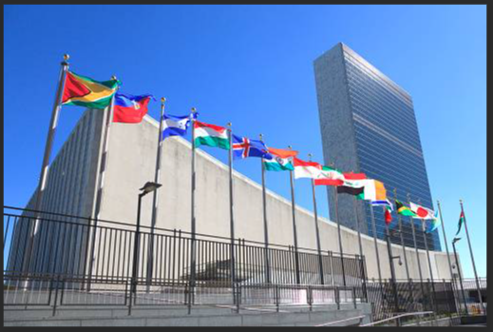
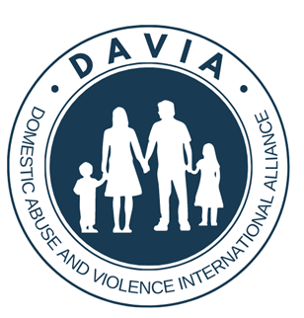
The United Nations Has Become Beholden to Feminist Ideology

Slide 2
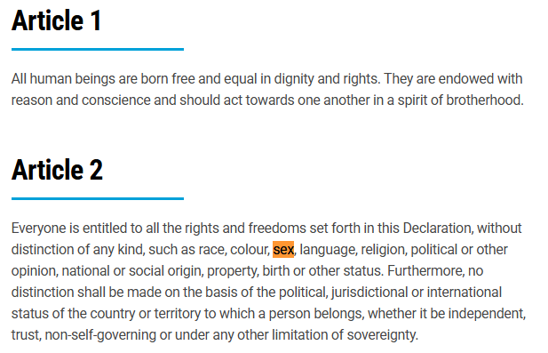
Universal Declaration of Human Rights -1948
Foundational document of the UN. Specifically prohibits sex discrimination:

Slide 3
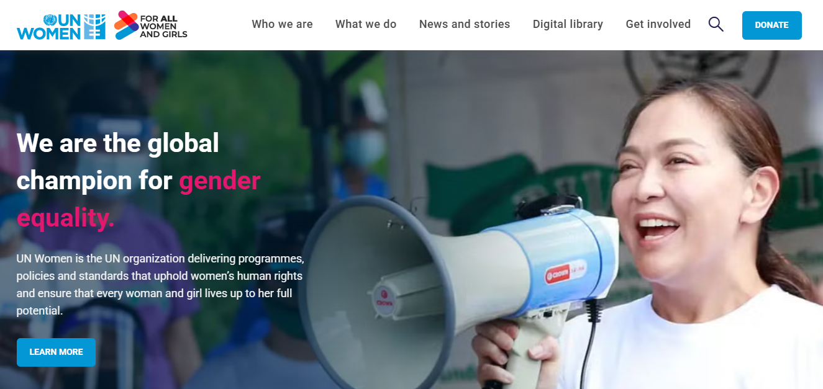
UN Women – Established in 2010
Now, feminist ideology permeates the United Nations, all in the name of “Gender Equality.”

Slide 4
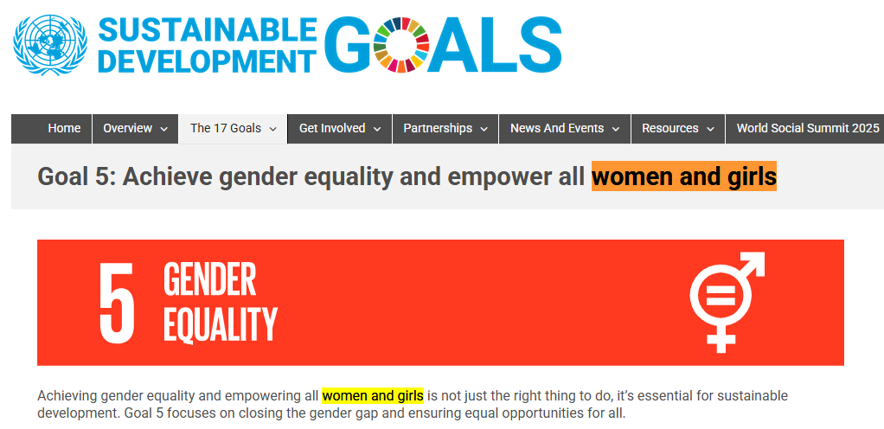
The “gender equality” agenda is aggressively promoted by the SDGs

Slide 5
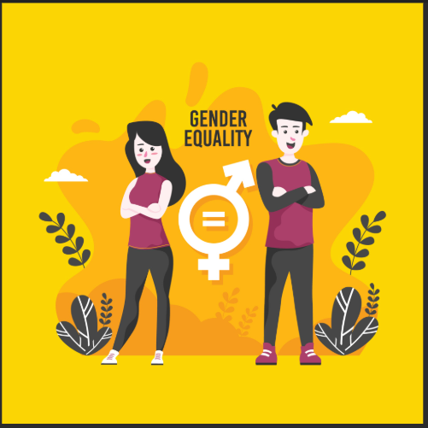
What about Gender Equality for Men?
By definition, “Gender Equality” applies to both
men and women.

Slide 6
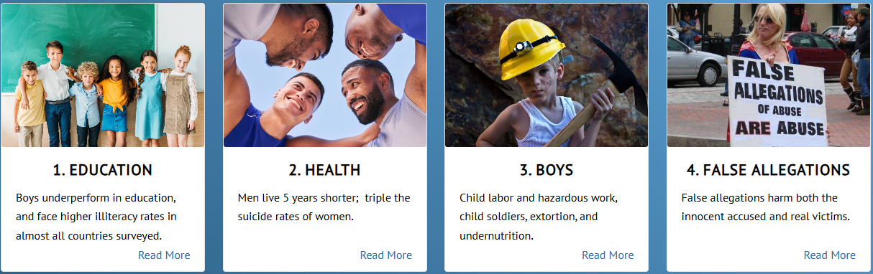
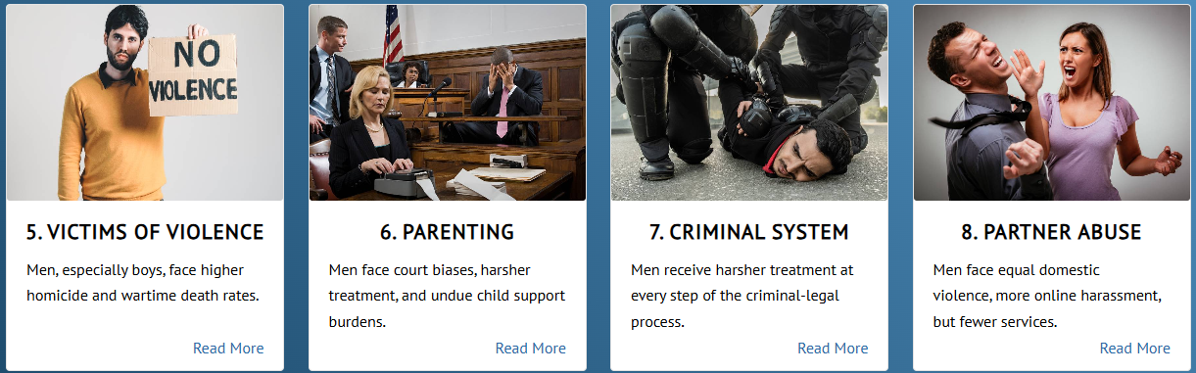
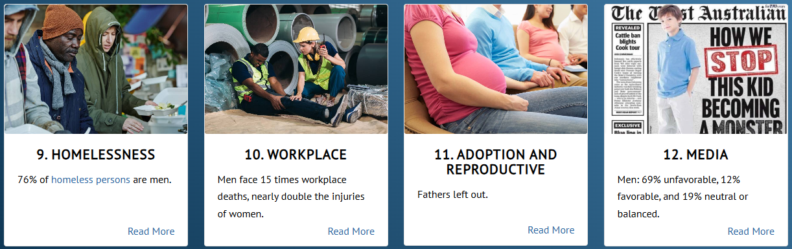
Around the world, men and boys are lagging in12 areas.
Link: www.menandboys.net

Slide 7

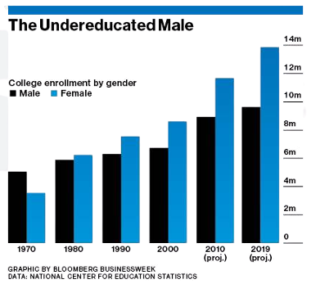
1. Education
The World Bank reports, “more than 100 countries
have lower levels of male secondary and tertiary
education enrollment and completion.”

Slide 8
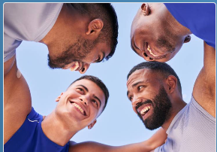
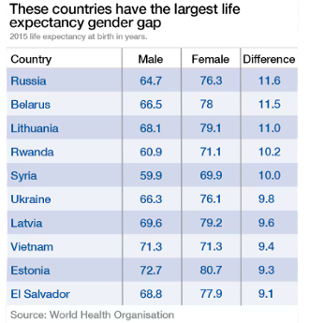
2. Health
World Health Organization:
Around the world, men face a
lifespan gender gap of 5 years.

Slide 9
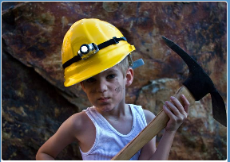
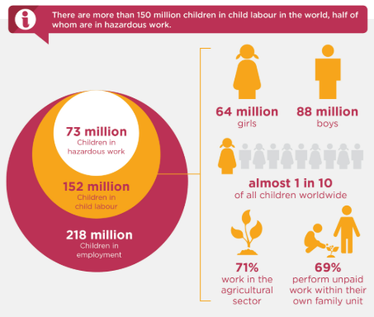
3. The Boy Crisis
International Labor Organization:
Among all children aged 5 to 17,
percentages in child labor:
Boys: 11.2%
Girls: 7.8%

Slide 10
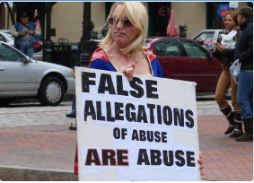
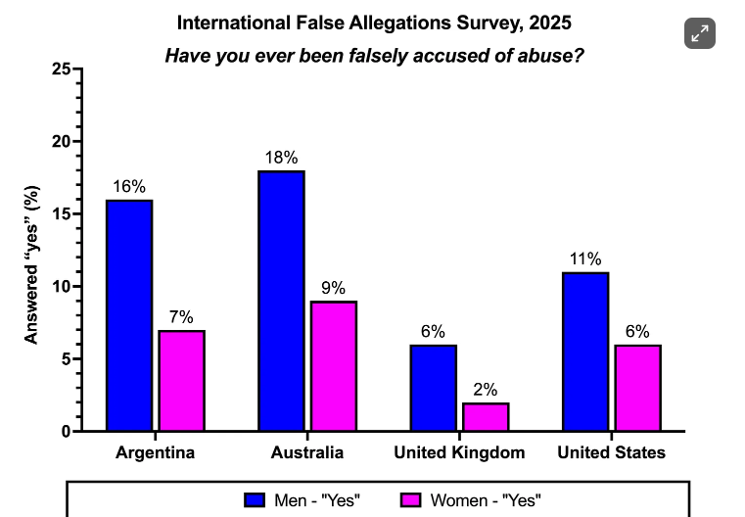
4. False Allegations
Men are twice as likely as
women be victims of a
false allegation of abuse.
2025 DAVIA survey ---->

Slide 11
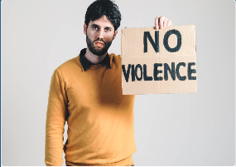
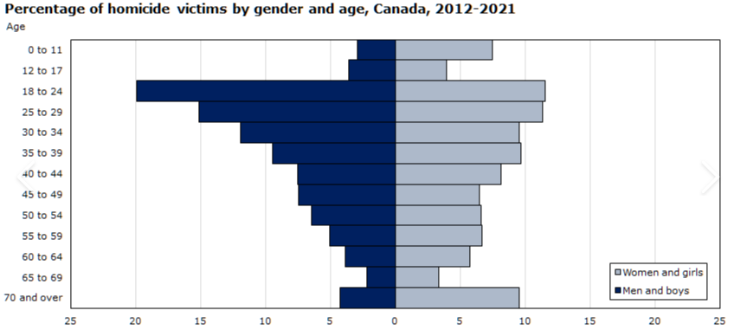
5. Victims of Violence
Males account for 78% of all homicide victims.

Slide 12
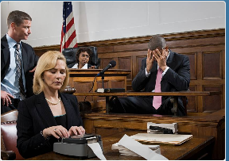
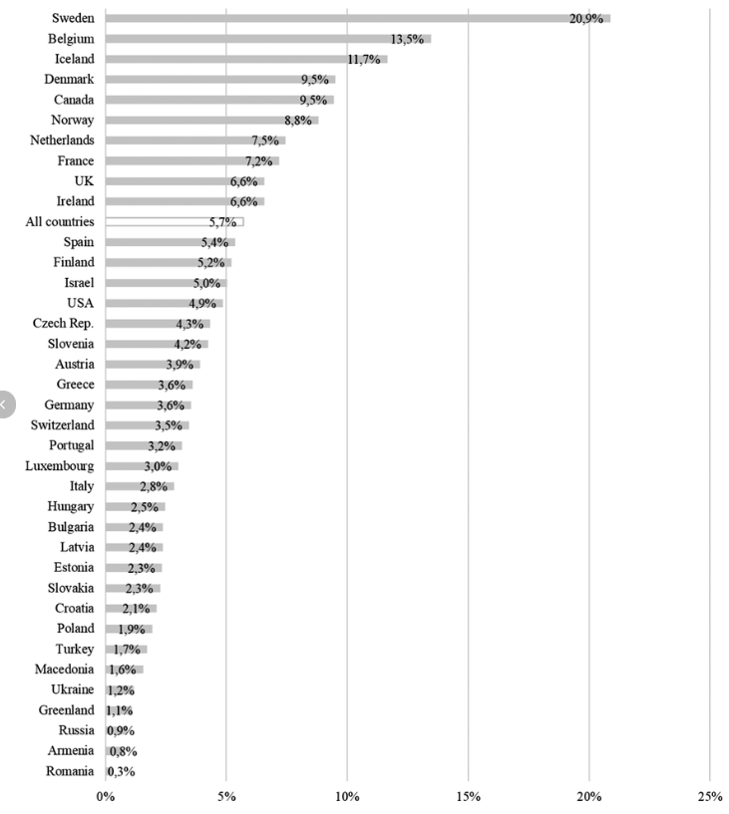
6. Shared Parenting
Survey in 37 North American and European countries:
Joint physical custody awarded in
fewer than 5% of cases.

Slide 13
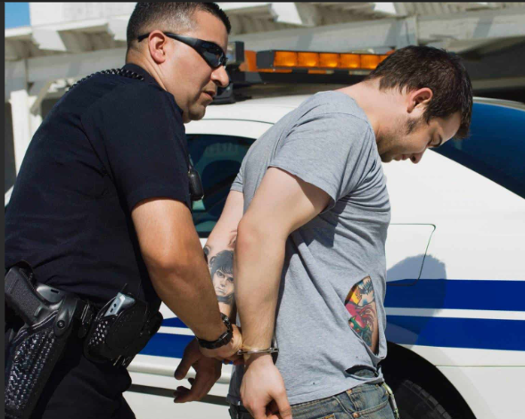
7. Treatment by the Legal System
Men encounter more severe treatment at every step of the criminal-legal process

Slide 14
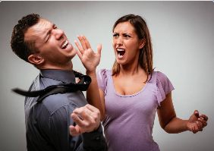
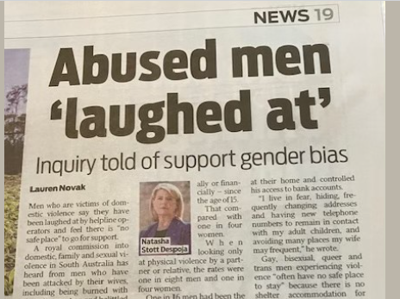
8. Domestic Violence
Far fewer services are available for male victims, even though men are equally likely to be victims of partner violence.

Slide 15
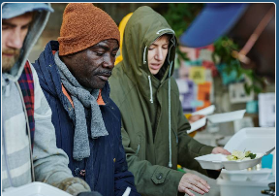
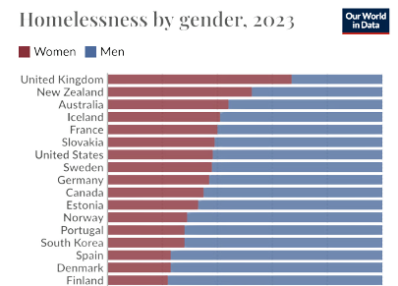
9. Homelessness
Globally, 76% of homeless persons
are male.

Slide 16
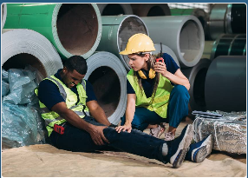
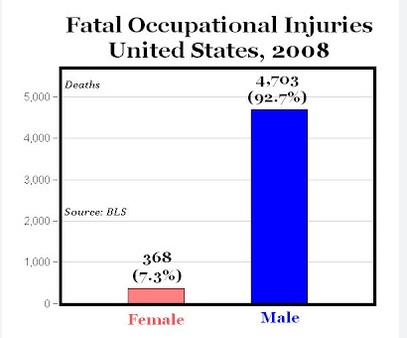
10. Occupational Deaths
Compared to women, men face 15 times the number of
occupational deaths from accidents:
Men: 6.2 deaths/100,000 workers
Women: 0.4/100,000 workers

Slide 17
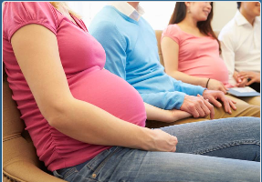
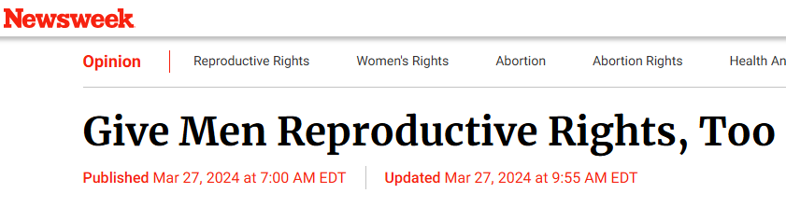
11. Reproductive and Adoptive Rights
In most countries, men have few or no adoptive and reproductive rights.

Slide 18
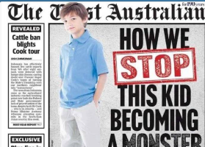
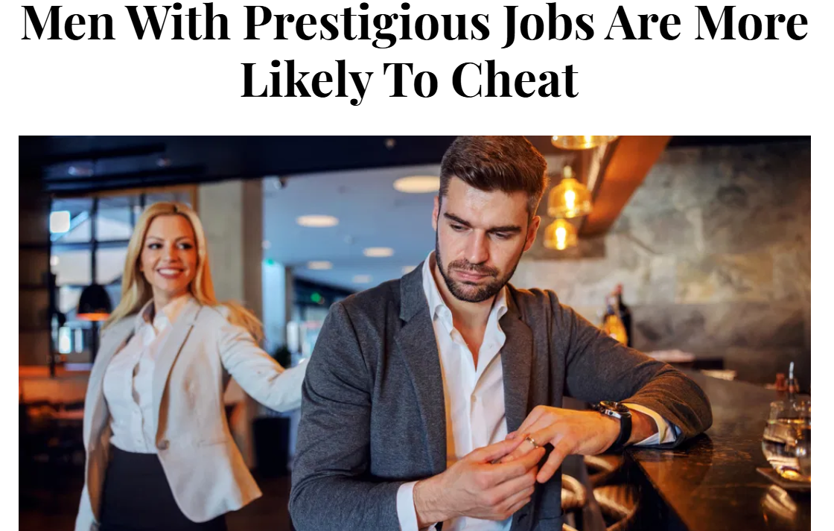
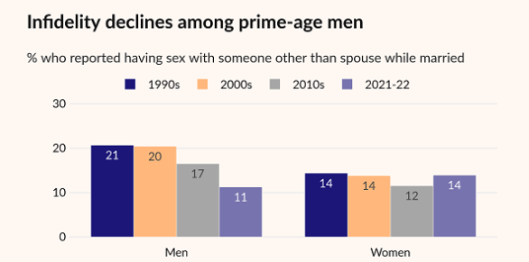
12. Media Portrayals
A multi-country analysis found that media portrayals of men are:
69% unfavorable, 12% favorable, and 19% neutral or balanced.
Recent example of bias -- by the Institute for Family Studies:

Slide 19
So what is the United Nations doing to address the 12 areas of male inequality?
We did an in-depth search for UN programs designed specifically for men, at these UN agencies:
1. World Health Organization
2. Human Rights Council
3. Others

Slide 20

The (somewhat) Good, the Bad, and the (very) Ugly…
The Good:
1. World Health Organization
2. Three publications on fatherhood

Slide 21
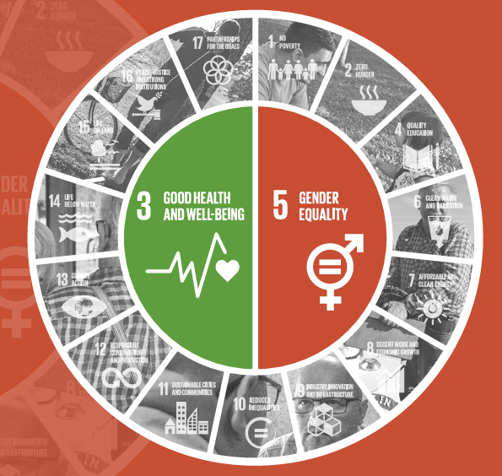
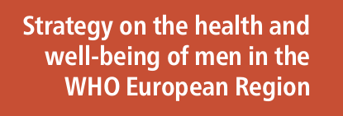
1. World Health Organization – European Region, 2018

Slide 22
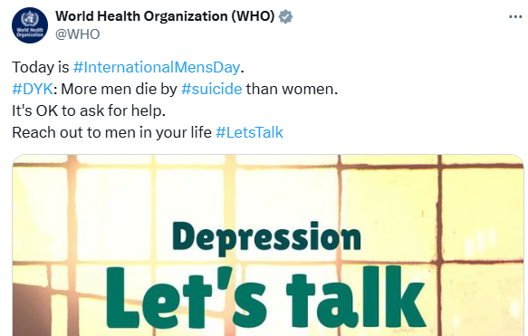
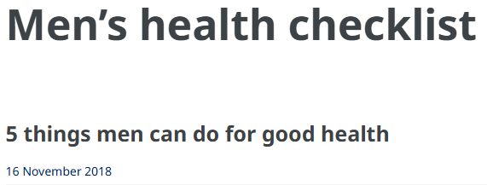
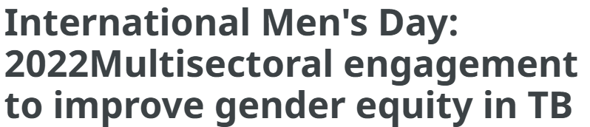
WHO: International Men’s Day, Nov. 19

Slide 23

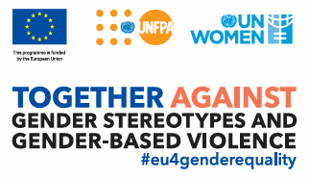
2. Three reports in recent years…
1. Department of Economic and Social Affairs, Fatherhood and Families, 2011
2. UNICEF: Family and Fatherhood: A Gender Transformative Approach, 2020
3. UNPF: Compendium on Fatherhood Programmes, 2021

Slide 24
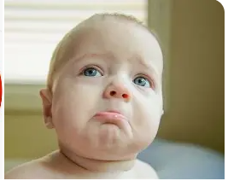
The Bad…
While the UN has placed some attention on men’s health and fatherhood, the other 10 areas of male disparity have been flatly ignored.

Slide 25
The (Very) Ugly…
1. Widespread Belief in the ‘Patriarchy’
2. Human Rights Council
3. Annalena Baerbock

Slide 26
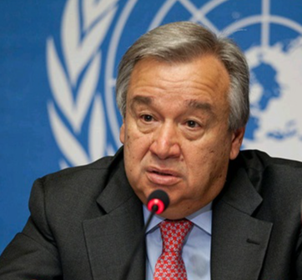
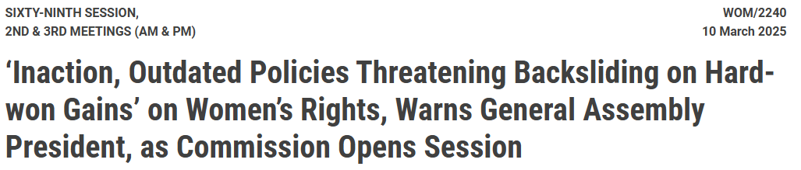
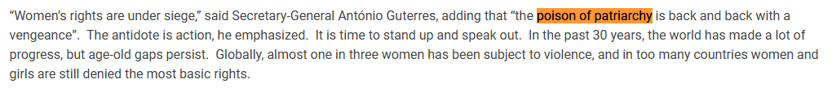
1. Widespread Belief in the ‘Patriarchy’

Slide 27
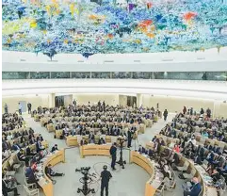
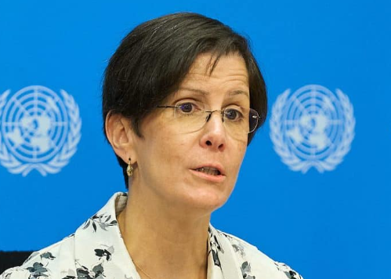
2. Human Rights Council
Reem Alsalem – Special Rapporteur on Violence Against Women and Girls
2023: “Custody, Violence Against Women and Violence against Children” -- claims parental alienation is an “unscientific pseudo-concept,”
2025: “Sex-based Violence Against Women and Girls” -- makes one-sided claims such as, “Violence against women and girls is a form of severe gender-based violence that takes place because of social and cultural norms pertaining to sex.”
DAVIA has done multiple press releases that reveal the fallacies of her claims: endtodv.org/parental-alienation

Slide 28
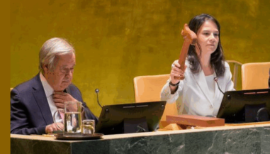
3. Annalena Baerbock
Baerbock was recently elected as the President of the UN General Assembly. She is a long-time proponent of gender ideology.
In her previous role as Germany’s Foreign Minister, she published a report on Shaping Feminist Foreign Policy:
“Feminist foreign policy is not foreign policy for women, but for all members of a society….And therefore it stands up for everyone who is pushed to societies’ margins because of their gender identity, origin, religion, age, disability or sexual orientation or for other reasons. Using this compass, it begins by examining entrenched power structures in order to pry them open. In doing so, it is rooted in critical self-reflection about our own history, faces up to historical responsibility, including for our colonial past, and is open to learning from others.”

Slide 29
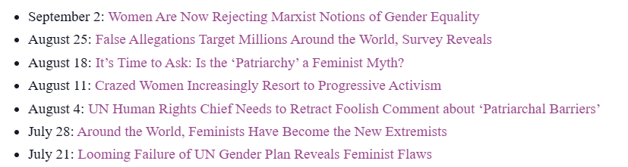
Strategies DAVIA has taken
1. New York Declaration for Men and Boys: www.menandboys.net/declaration/
2. Meetings with UN missions to explain 12 areas of male disparity. Response
has been generally positive.
3. Recent press releases that expose the UN’s
failure to address gender equality for men:

Slide 30
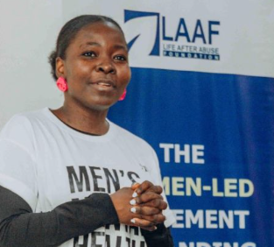



Proposal to establish UN Men

Slide 31
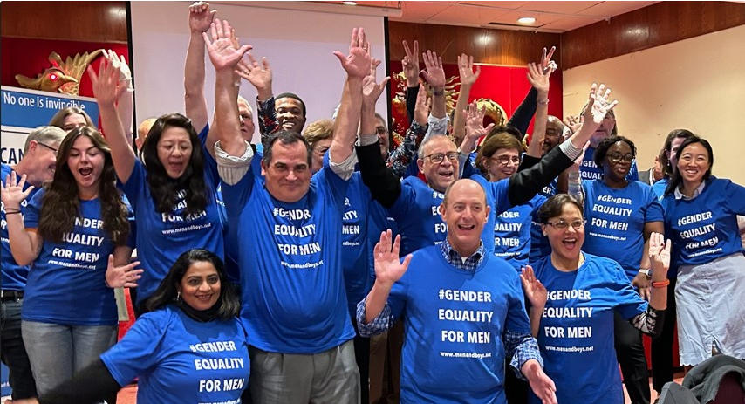
Questions and discussion

